Slide 1
Megathon-22
int_elligence=0

Slide 2
Problem Statement
Enhancing the travel experience for Passengers

Slide 3
Challenges
Honking unnecessarily when not needed which cases discomfort.
Loud music sometimes drowns the sound of Sirens from Emergency Vehicles.
Audio impaired or people hard of hearing unable to drive without assistance.
People with compromised backbone on a bumpy road can be pain

Slide 4
Proposed Solutions
Selective ambient audio preference ( Horns , Sirens ) or Auditory Replacement using LTI Convolvers/AI Based.
Active Suspension system which can smoothen the bumpy roads.
Steering Haptics to provide directional feedback and subtle feedback from oncoming traffic.
Visual and Haptic based cues for surrounding sounds.

Slide 5
->
Selective Audio Equalisation

Slide 6
Selective Audio Equalisation
Assuming a 60 dB sound-proof vehicle, A Quad microphone array can be used to reproduce external ambient sounds inside the car
Since the audio is passing through audio systems, conventional filters can be used to isolate Engine hum.
Additional AI based filters can be used to selectively filter/suppress Honking .

Slide 7
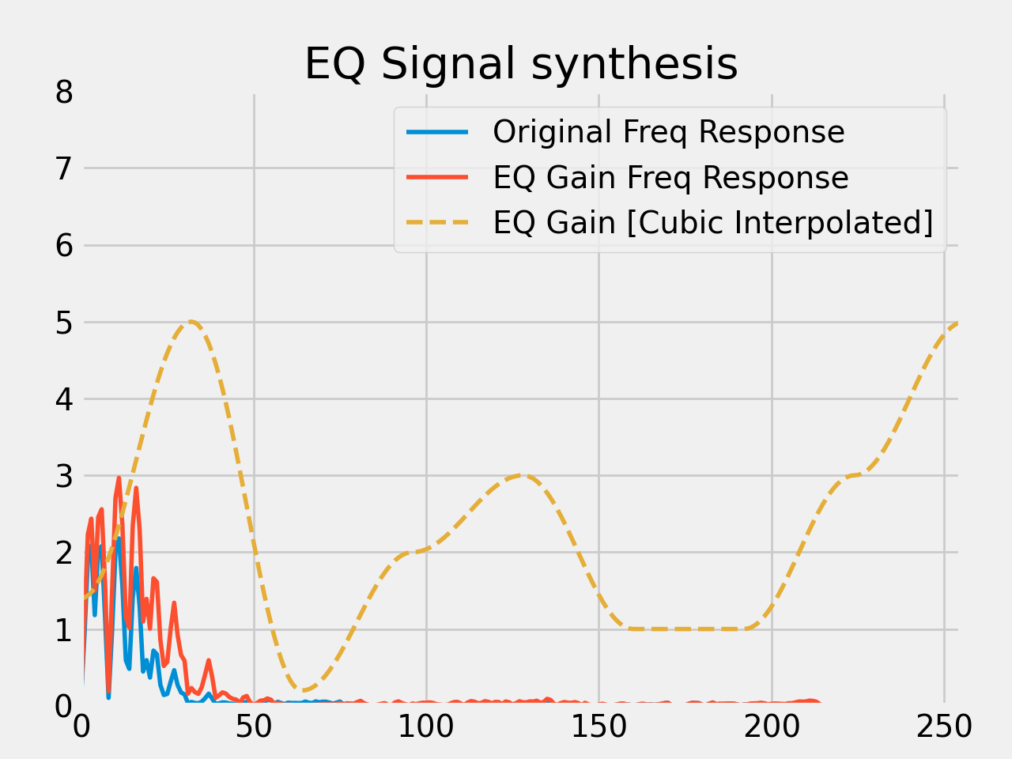
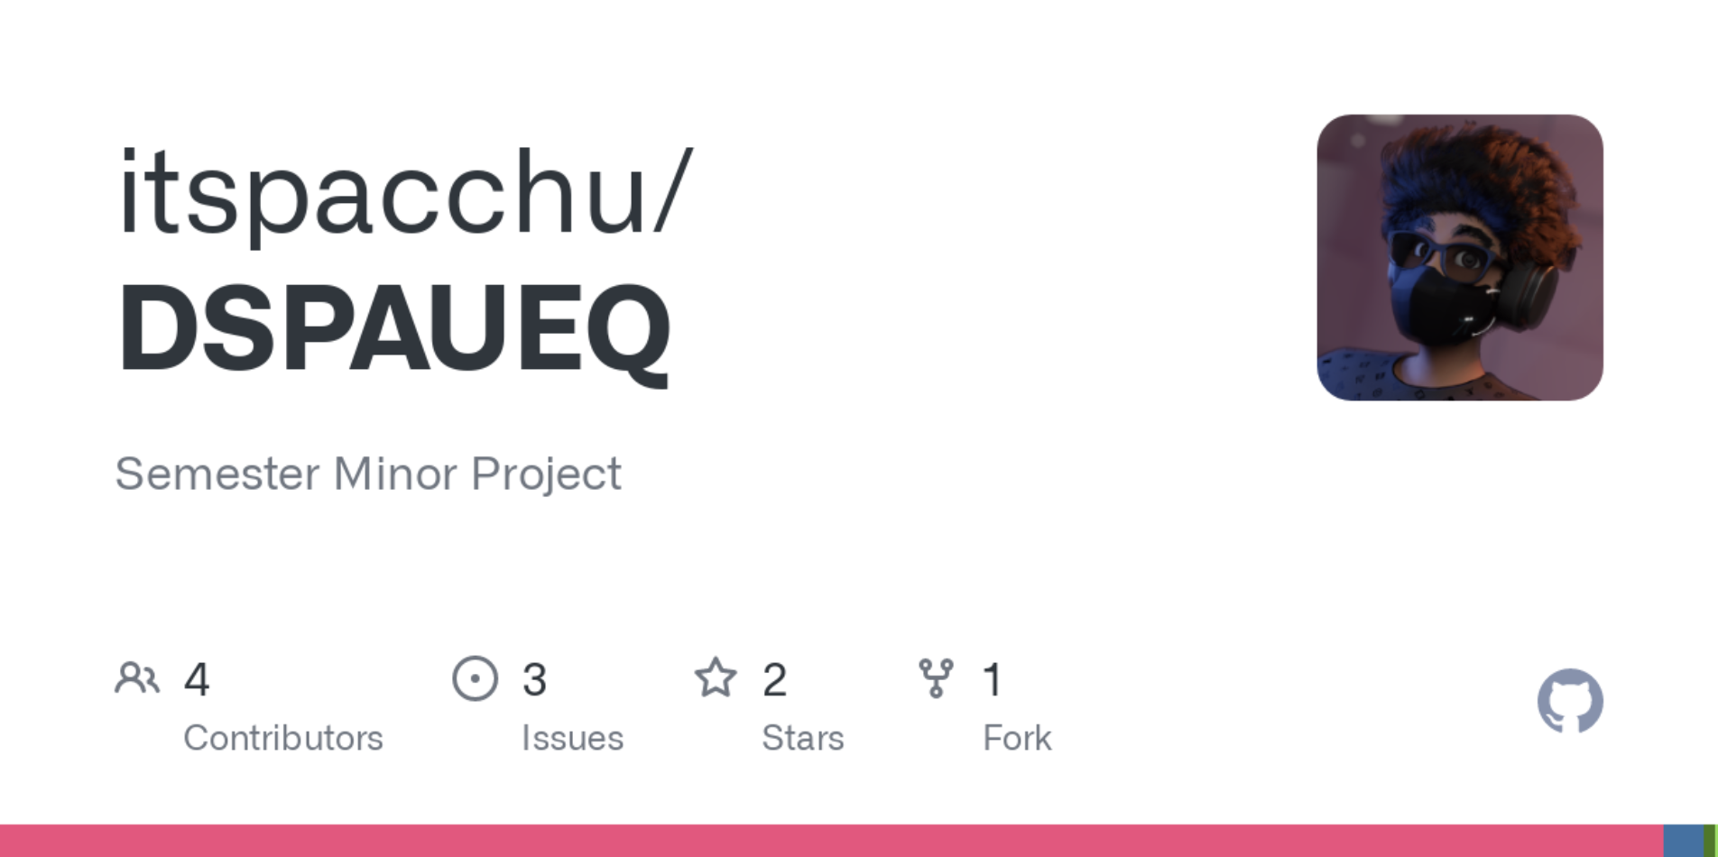
Selective Audio Equalisation
Engine Hum
Emergency Sirens

Slide 8
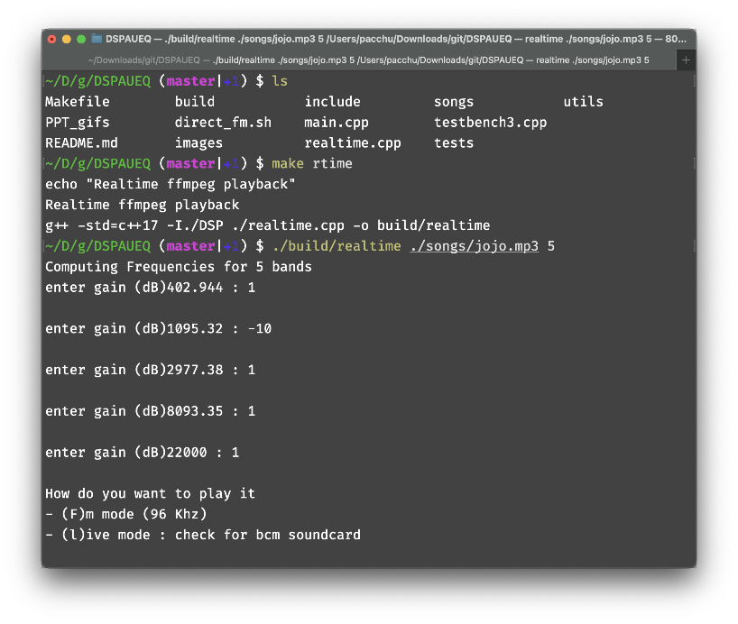
Selective Audio Equalisation
Basic FIR based Audio filtering

Slide 9
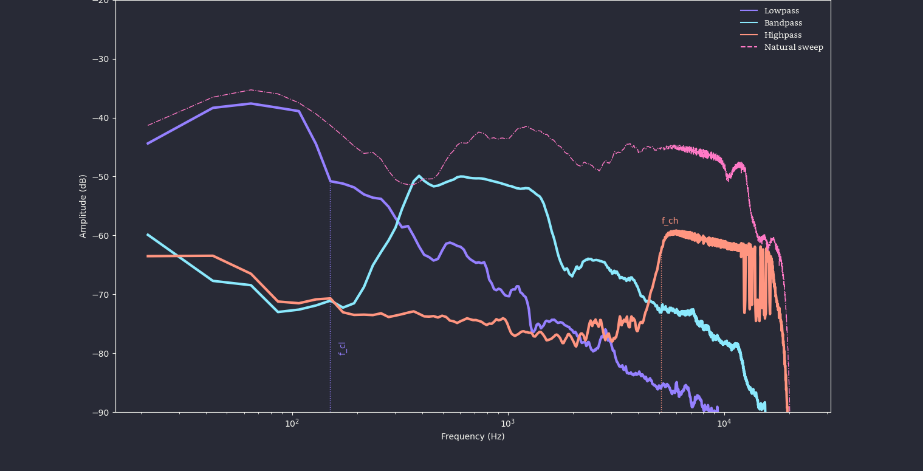
Filter Responses

Slide 10
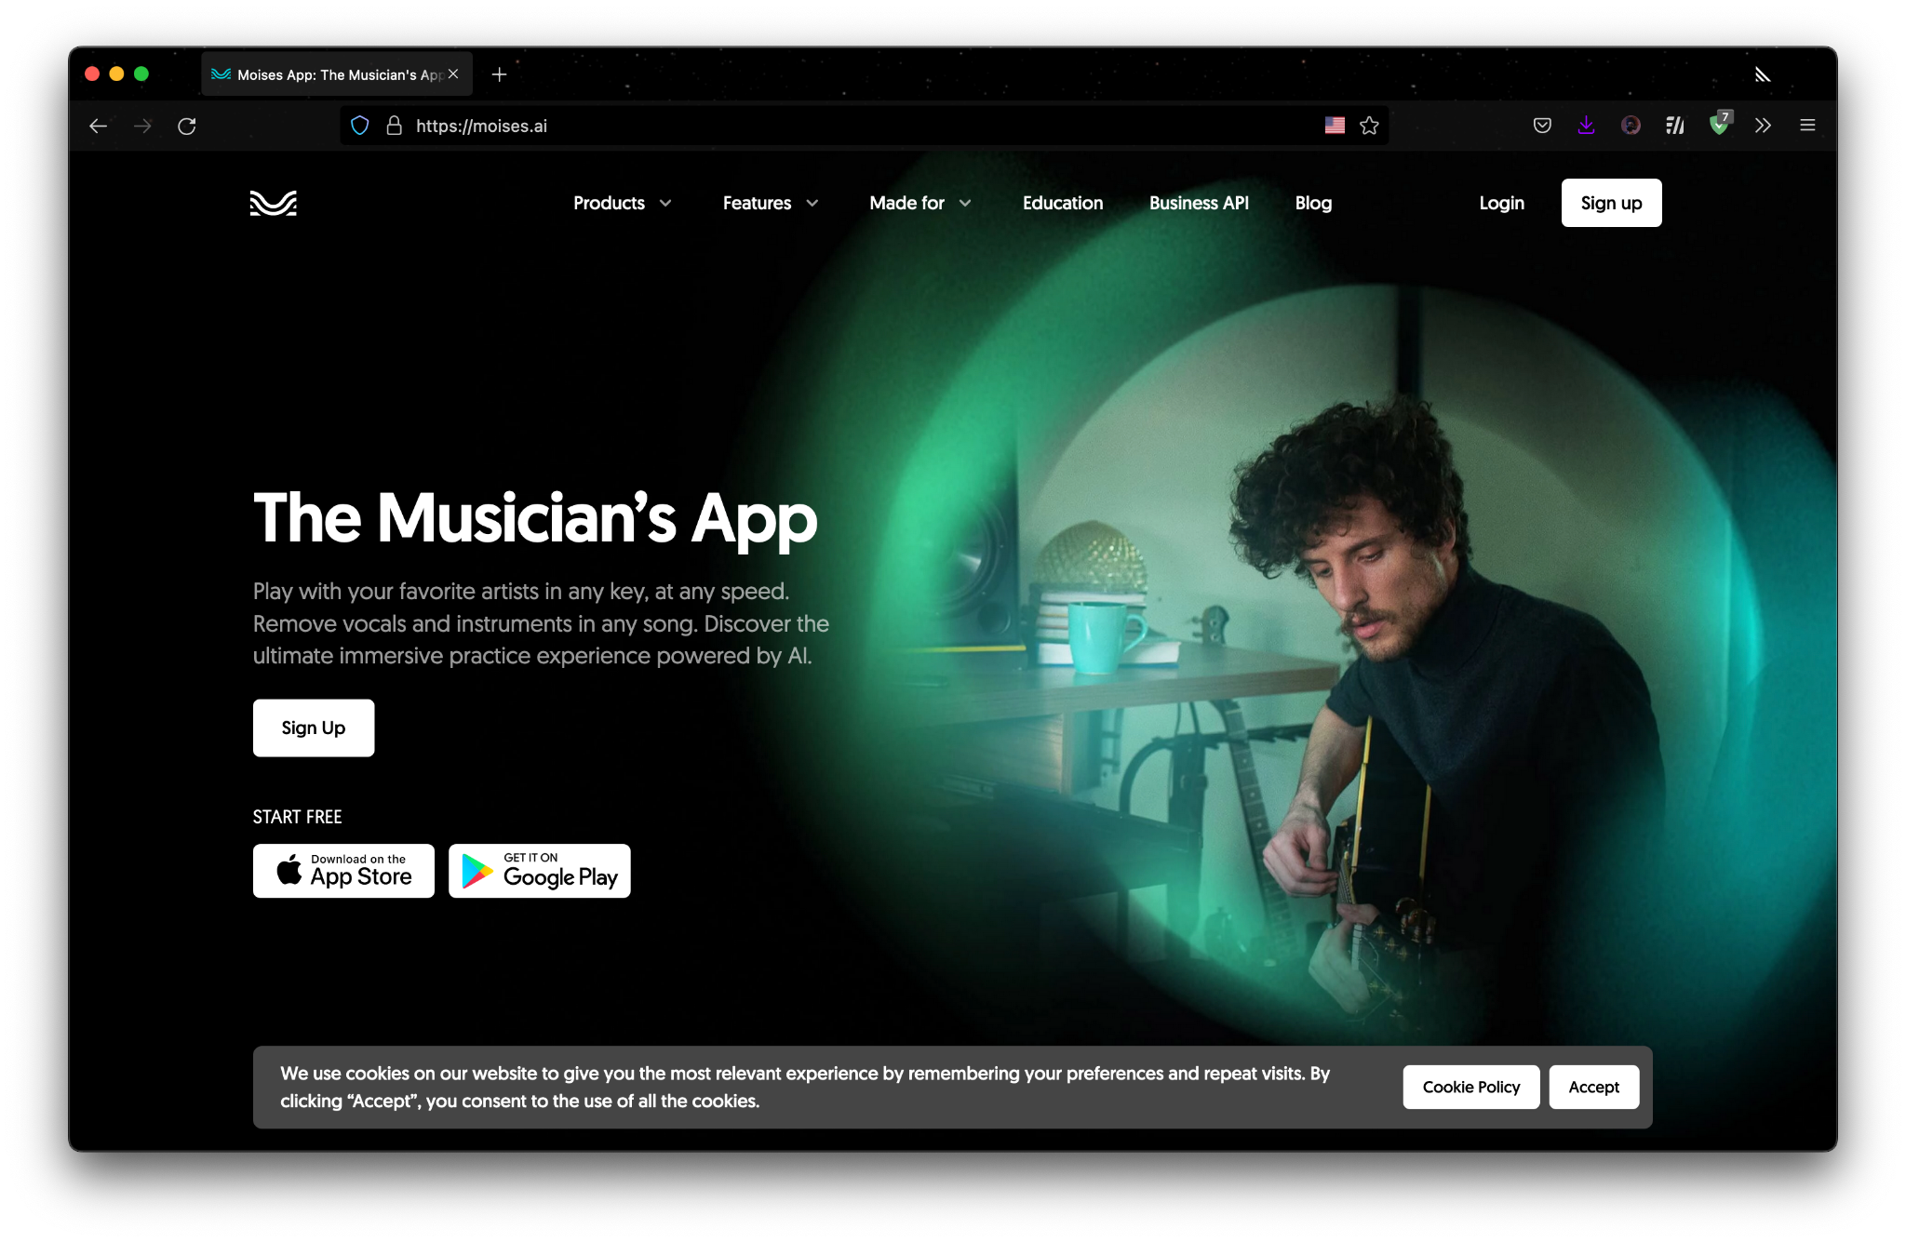

Selective Audio Equalisation
AI based audio segmentation

Slide 11
->
Steering Haptics

Slide 12
Steering Haptics
Multiple actuators placed all around the steering wheel can provide a comforting feedback from car surroundings.
This allows us to map the data coming from the quad microphone array to parse location data of important events and map it onto the steering wheel with custom vibration patterns.
This mapping of audio cues onto haptics on steering allows deaf and auditory compromised people to operate vehicles normally
Notes:
Heavily inspired from games like overwatch and destiny Haptics mapping

Slide 13
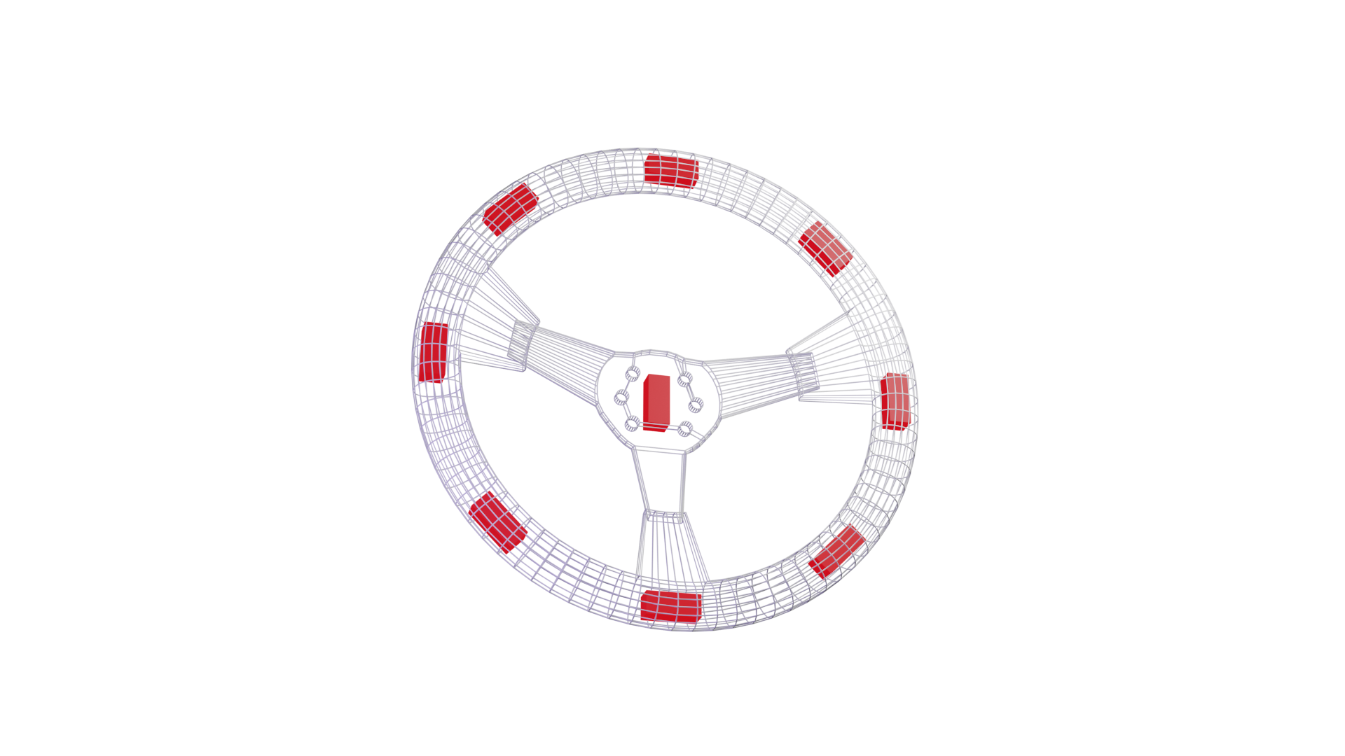
Steering Haptics
Central Actuator
Individual Actuators
Notes:
Heavily inspired from games like overwatch and destiny Haptics mapping

Slide 14
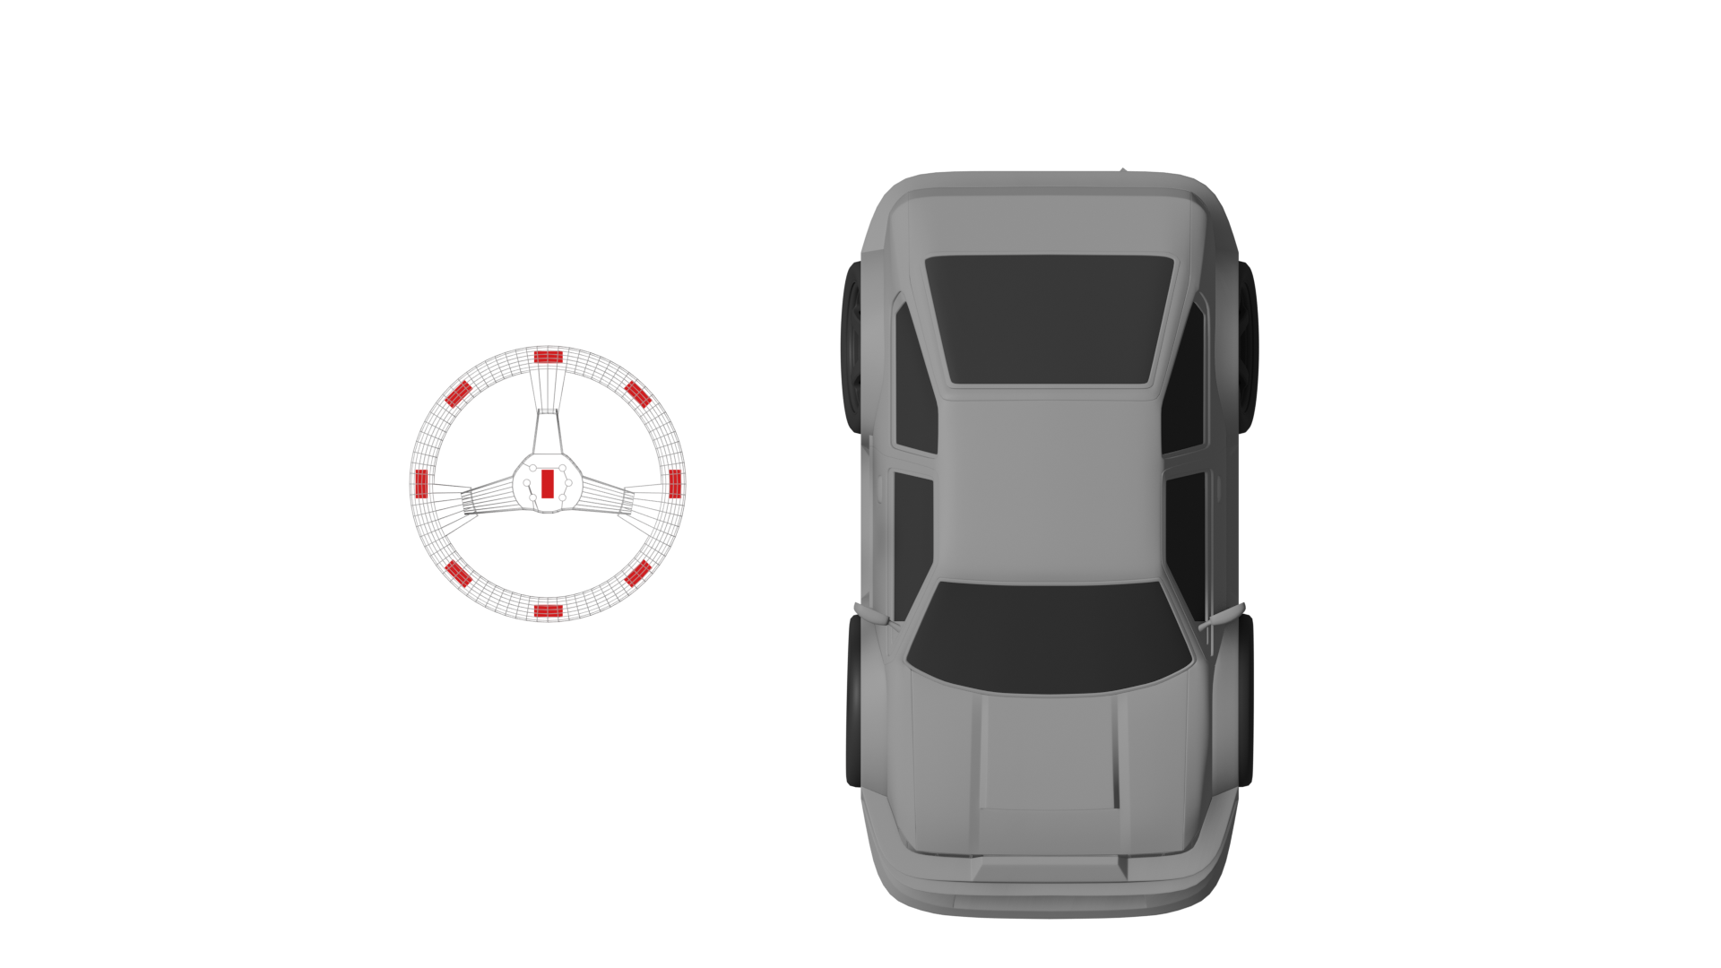
Steering Haptics
Notes:
Heavily inspired from games like overwatch and destiny Haptics mapping

Slide 15
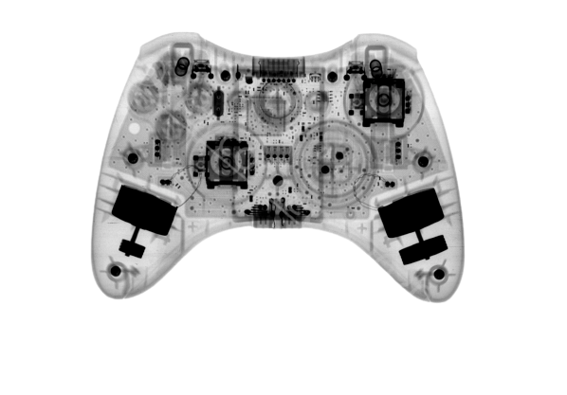
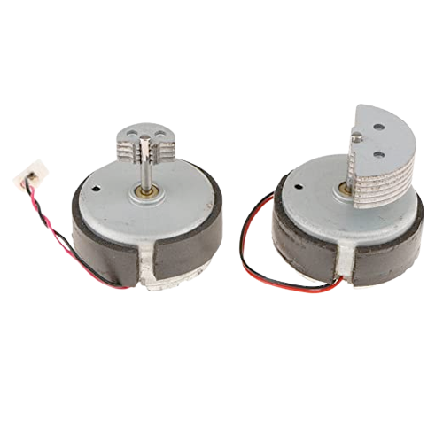
Steering Haptics
Inspired from game controllers
Notes:
Heavily inspired from games like overwatch and destiny Haptics mapping

